Slide 1

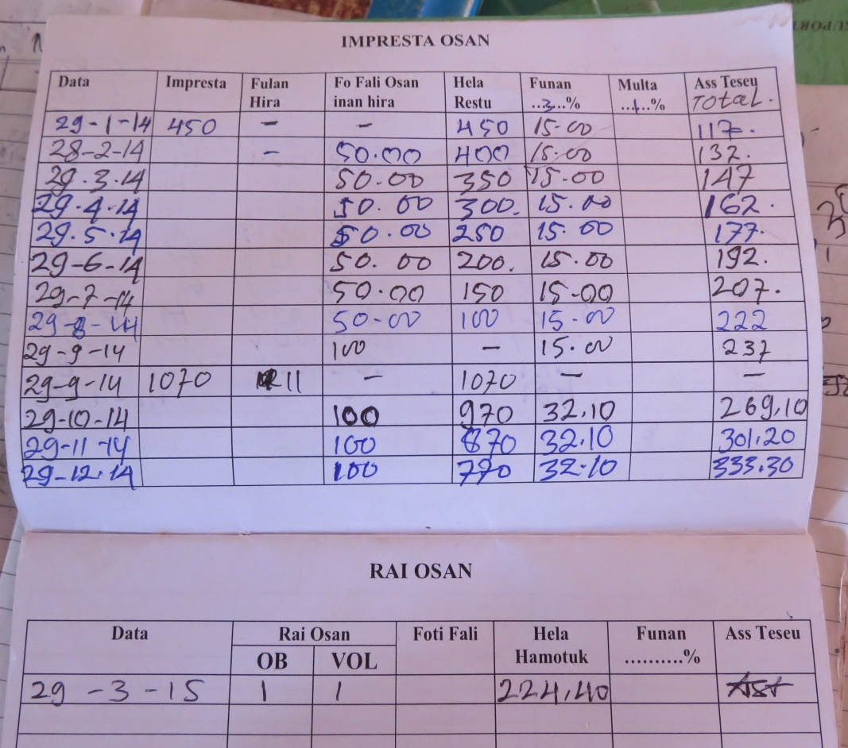
Gender analysis of Oxfam-partnered savings and loans groups
Cristina Benevides, Lucia Viana Branco,
Sara Niner & Katy Cornwell
Notes:
Good morning,
Thank you for the opportunity to make this presentation !
My name is Lucia Branco and I work with OXFAM as a Livelihoods Officer. I was able to accompany the research team in the field.
I would like to share information about OXFAM’s support for savings and loans activity in Timor-Leste and our recent research with Monash University.
In Timor – Leste, and especially in rural areas, access to credit is limited. In the districts, there are still many people who are illiterate, have limited access to lending institutions, have little experience of the benefits of saving and who have to depend on borrowing from their families if there is an urgent situation , such as the need for school fees , health care, food or expenditures for traditional ceremonies. Often credit is not available, with impacts on health, education and family relationships.
Because of this lack of access to credit, since 2005 Oxfam has introduced the concept of savings and loans to communities, facilitating the establishment of savings groups (UBSPs) in the district of Oecusse, Covalima , Manatuto , and Liquica. The main purpose of the savings group is to encourage people to save small amounts of money on a regular basis to build up group funds that can be used when there is an urgent need (education and health costs, food, ceremonies), or as capital to diversify people's livelihoods (kiosks, seeds etc). Groups often lead to increased mutual support and labor-sharing and even the development of cooperatives to support agricultural production.
Women are taking up roles of leadership, participating in savings and loan group decisions on granting loans, and sometimes appear to have more control of household income. There are also women who are starting micro businesses and have a degree of control over their own income. What are the factors that enable many women to participate, lead and benefit from these groups?

Slide 2
OUTLINE
Introduction
Research objectives
Study design
Results: demographic data
Findings and recommendations
Notes:
For the presentation, we will talk about 5 points as (see on the up)
Oxfam and Monash University have worked together to undertake research to understand more about the social dynamics of these groups through a gendered lens to ensure that negative impacts - such as increased work burdens, or ‘backlash’ against women – are mitigated and positive benefits are maximized.
The groups have been initiated over a long period of time as part of various umbrella programs and were not designed as a specific gender empowerment initiative. However, there is a belief within Oxfam, echoed elsewhere in the development industry, that women significantly benefit from these groups. This fits in with wider beliefs that microfinance programs in general are an excellent empowerment initiative for women.
Development agencies hope that womentake up roles of leadership within these groups and participate in decision-making on granting loans and that this facilitates not just processes of economic empowerment for women but also social empowerment and wider social change.
The outcomes of this research will be used to inform the ongoing work of Oxfam to improve gender equity and reduce poverty in Timor-Leste. Oxfam and partners will be able to develop better informed programs and strategies, and a have access to a greater evidence base with which to influence national policies related to rural development. Research outcomes will also enhance the understanding of government, local and international agencies, thereby informing policy and practice related to rural Timorese women’s access to and control of finance.

Slide 3
INTRODUCTION
Oxfam supports around 100 savings and loans groups in four municipalities: Ainaro, Covalima, Liquica and Oecusse.
Oxfam supports the groups through Local NGOs as implementing partners.
This program in Indonesian is called UBSP (Usaha Bersama Simpan Pinjam) which means ‘working together to save and borrow’. or in Tetum GREO (Grupu Rai no Empresta Osan)
Notes:
UBSP development activities from 2005 to 2014 have grown in response to the perceived success of the groups with the addition of new members and groups. Oxfam is now the biggest single supporter of savings and loans groups in Timor-Leste with 86 groups with membership of 1453 women and 1264 men in the four districts of Oecusse , Covalima , Liquica , and Ainaro.
Oxfam provides our local partner organisations with training on group management and savings and loans practices and how to monitor the groups.

Slide 4
INTRODUCTION
The groups are usually composed of family members and the local community (Aldeia) want to protect and improve the economy of their household.
The groups conduct monthly meetings to collect regular savings contributions from each member (from $ 0, 50 cent to $2).
Members (and sometimes external community) can borrow money from the group’s savings, and then repay with interest.
Later, the group can decide to divide the money, so they each receive their share of savings and interest earned by the group.
Notes:
The UBSP program is strongly based on local institutions where there is a good level of social trust.
The UBSP program works at an appropriate scale with small amounts of money according to local capacity.
The UBSP program provides direct access to small loans without collateral. Groups decide their own rules. Oxfam is working with partners to review best practice in the groups, particularly around the annual break and sharing of savings.
Why does OXFAM want to implement and improve support for UBSP for rural communities?
Oxfam implements UBSP activities because it believes UBSP groups can contribute towards improvements in the economic condition (based on access to finance), social cohesion, women’s leadership, and the social safety net for communities in rural areas.

Slide 5
RESEARCH OBJECTIVES
To assess Oxfam practice: “do no harm”
To understand the methods and progress of savings and loans groups supported by Oxfam
To identify the challenges faced by groups
To identify what is working well, and why
To identify any challenges to equal participation in groups for men and women
To make recommendations for the future.
Notes:
Oxfam would like to understand more about the social dynamics of these groups through a gendered lens to ensure that negative impacts - such as increased work burdens, or ‘backlash’ against women – are mitigated and positive benefits are maximized.
The groups have been initiated over a long period of time as part of various umbrella programs and were not designed as a specific gender empowerment initiative. However, there is a belief within the organization, echoed elsewhere in the development industry, that women significantly benefit from these groups. This fits in with wider beliefs that microfinance programs in general are an excellent empowerment initiative for women. Development agencies hope that womentake up roles of leadership within these groups and participate in decision-making on granting loans and that this facilitates not just processes of economic empowerment for women but also social empowerment and wider social change.
While there is demonstrated positive change, it is also possible that participation in savings and loans groups may add to the work burdens of women or that changes in status may result in negative outcomes for women. Analysis of risk and risk mitigation is therefore essential.
This research is helping Oxfam to understand about the methods and the progress of UBSP system and assess how we can support savings and loan programs and support for gender empowerment in our new Integrated Rural Development program,

Slide 6
STUDY DESIGN
Location
This research covered 17 groups in:
Liquisa (2)
Ainaro (4)
Covalima (4)
Oecusse (7)
Types of Group
Mixed-gender groups – male dominated & female dominated
Women-only groups
Men-only groups
Notes:
Within the Oxfam-partnered groups in Timor-Leste women in women-only groups make up just over 10% of the total number of members. The single gender groups were examined in comparison to the social-dynamics of mixed gender groups

Slide 7
STUDY DESIGN
Method & Target
Local NGO or implemented partner (individual interviews)
Women members (focus group discussions)
Man members (focus group discussions)
Group leaders (individual interviews)
All group members: demographic survey
Notes:
The research used a variety of strategies to talk with all stakeholders.

Slide 8
Results: Demographic Data
% With Some Education
 | Female | Male | Total
Ainaro | 65% | 86% | 70%
Covalima | 75% | 78% | 76%
Oecusse | 53% | 44% | 49%
Total | 60% | 58% | 59%
Education levels on average lower in Oecusse & higher in Covalima
Notes:
In our research we found that the levels of education of group members are low, we can see, men and women in Oecusse have a very low % of education. For Covalima men and women have a similar % of education.
Low levels of education and high levels of illiteracy are significant. Public counting of money and oral reporting of loans, savings and repayments is important for many groups.
This will have an impact on the savings and loans groups in the future, if cannot remember how much their money in the groups. It makes it difficult for groups to access big cooperative banks in their village or the new rural banks.
That’s why, make OXFAM with their partners will develop new designs that acknowledge challenges around education and literacy for the savings and loans program in future.

Slide 9
Results: Demographic Data
Average Loan Amount
 | Female | Male | Total
Ainaro | $138 | $117 | $134
Covalima | $403 | $550 | $457
Oecusse | $76 | $84 | $80
Total | $147 | $176 | $157
Loan amounts on average lower in Oecusse,
higher in Covalima
Notes:
There are similarities between the general level of loans for men and women but there are differences between districts.

Slide 10
Findings & Recommendations
1. Groups are based on prior networks and modes of sociality.
“men and women complete each other” /
“mane feto kompleta malu”
“we sit together” / “tuur hamutuk”
2. Groups are a vehicle for building economic and social resilience and protection including a sense of agency or empowerment.
Notes:
Groups work because the members know and trust each other. This makes scaling up difficult.
Groups can see that they can be successful – even if only a small amount of money it is a small amount that makes a difference.

Slide 11
Findings & Recommendations
While most groups mainly focus on managing basic needs of households, groups have the potential to create innovative, entrepreneurial livelihoods.
4. Lack of education (basic literacy and numeracy) hampers group and individual development and the implementation of USBP methodology.
Notes:
The groups provide social protection through access to loans for food, school fees and medicines and transport.
Members also use loans to buy seeds, equipment for food processing and to start small kiosks.
We need to adapt our approach to acknowledge members who are illiterate.

Slide 12
Findings & Recommendations
Groups are the perfect vehicle to build on women status as superior money managers, more trustworthy and transparent group administrators and calm and patient leaders.
6. A minor problem of women’s participation in savings and loans groups and a barrier for their participation was the increasing burden and conflict between their reproductive and productive duties.
Notes:
Groups give women the opportunity to be leaders and to give men the opportunity to see that women have capacity.
However in some cases participation caused problems for women. Some groups have found that encouraging husbands to understand about the groups or participate in them has been a way to reduce this conflict.

Slide 13
Findings & Recommendations
7. Mixed gender groups can entrench gender discrimination or become vehicles for building gender equity.
8. Women-only groups can be avenues for empowerment but currently few have this agenda.
Notes:
UBSPs are not a magic way to achieve gender justice. The approach to UBSP management and the focus on participation, leadership and changes in gender roles need to be part of the approach.

Slide 14
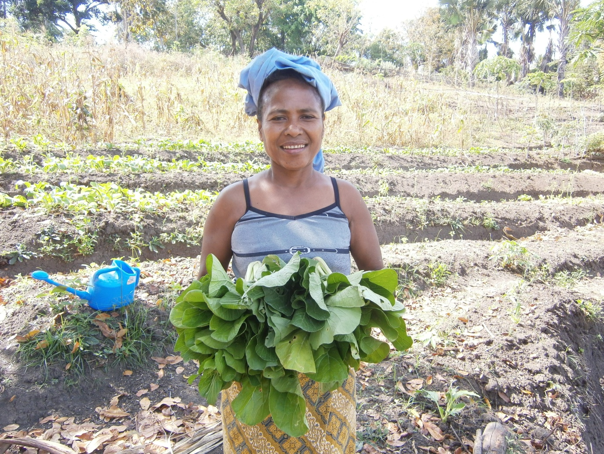
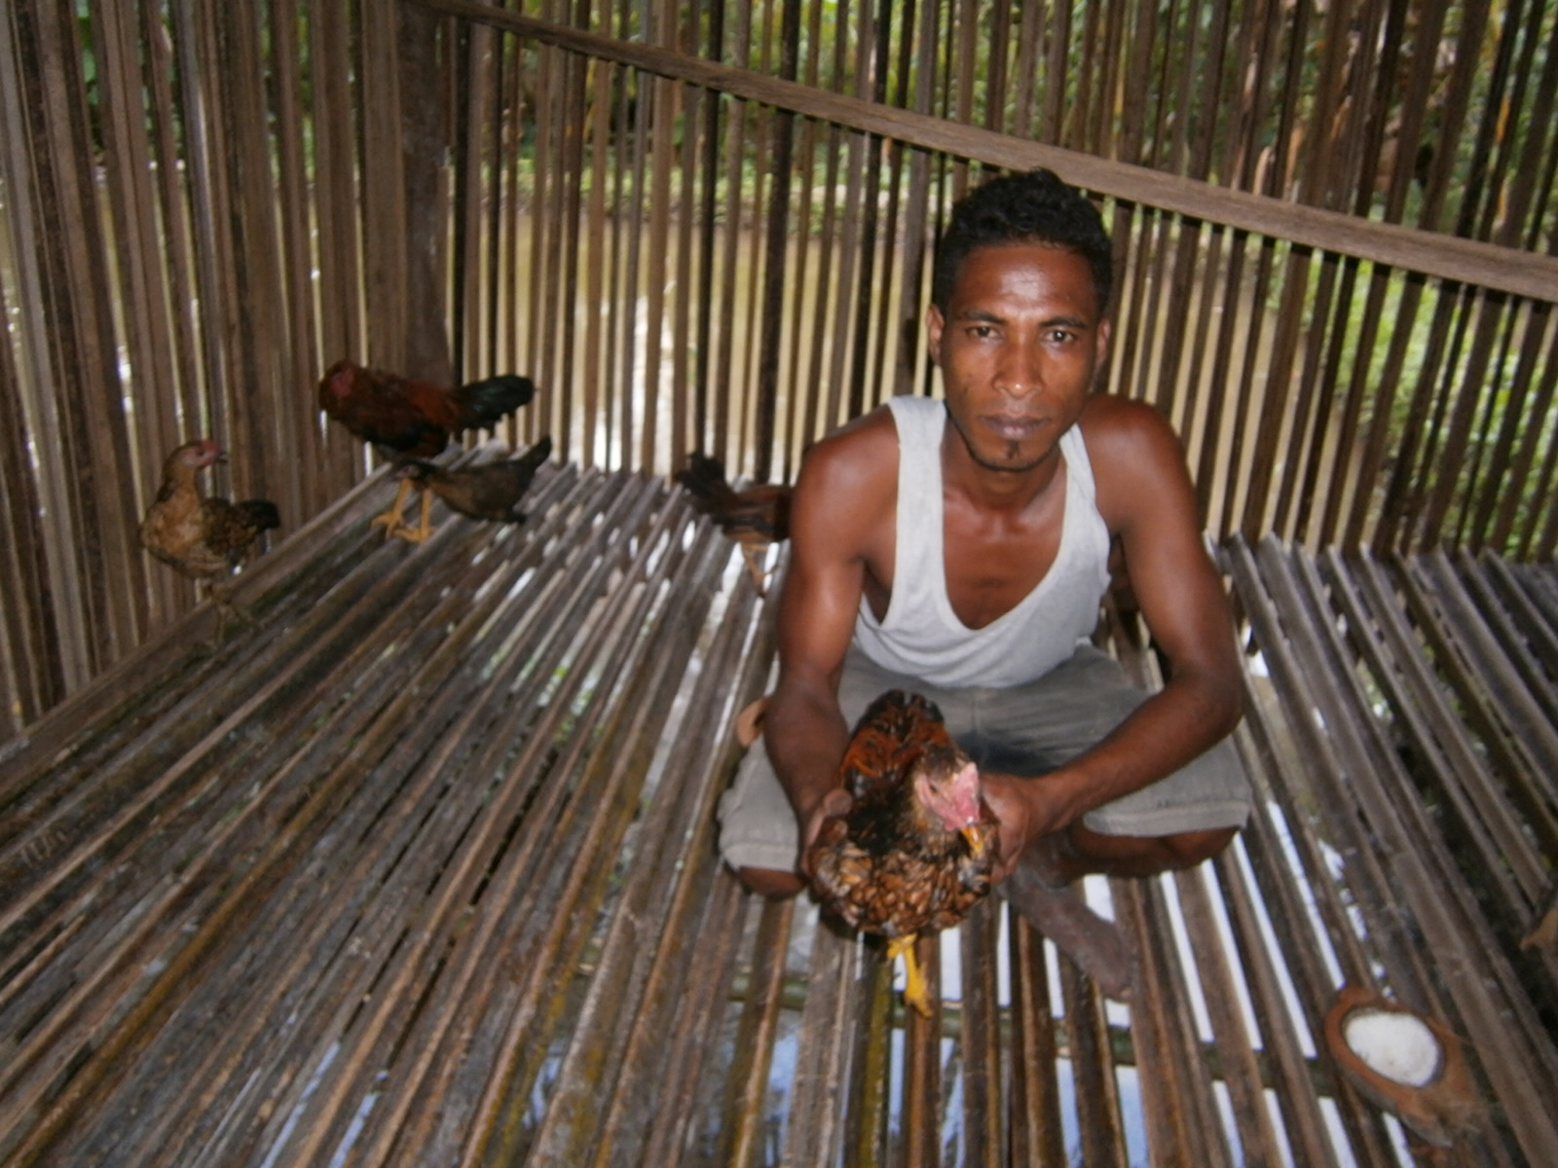
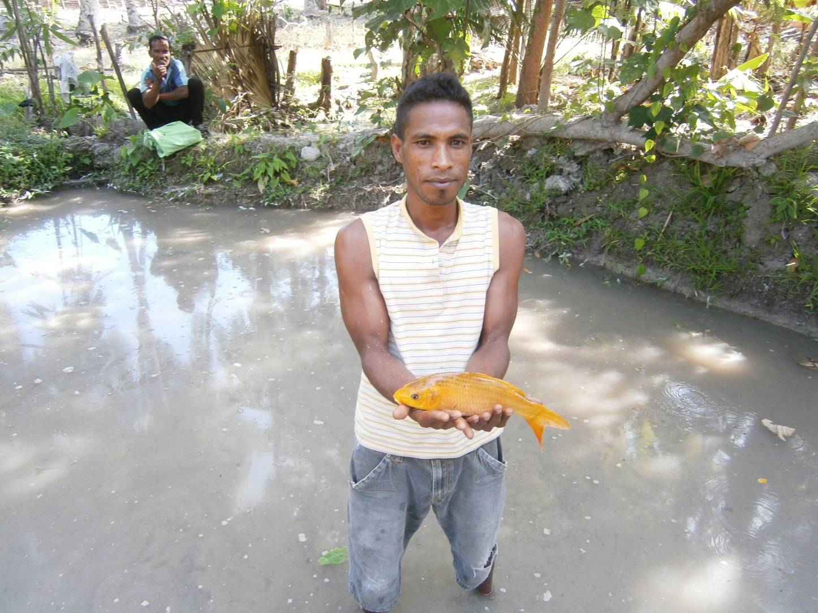
The Success of UBSP Group
I loaned money from the group for vegetable seeds, which I planted and grew and then sold the produce
I loaned money from the group to buy chickens, which I looked after and then sold for more money when they were bigger
FG UBSP Labadaif – Hatu Udo, Ainaro
FG UBSP Honehunia-Hatu Udo, Ainaro
I loaned money from the group for baby fish which I looked after and then sold for more money when they were bigger
FG UBSP Honehunia-Hatu Udo, Ainaro

Slide 15
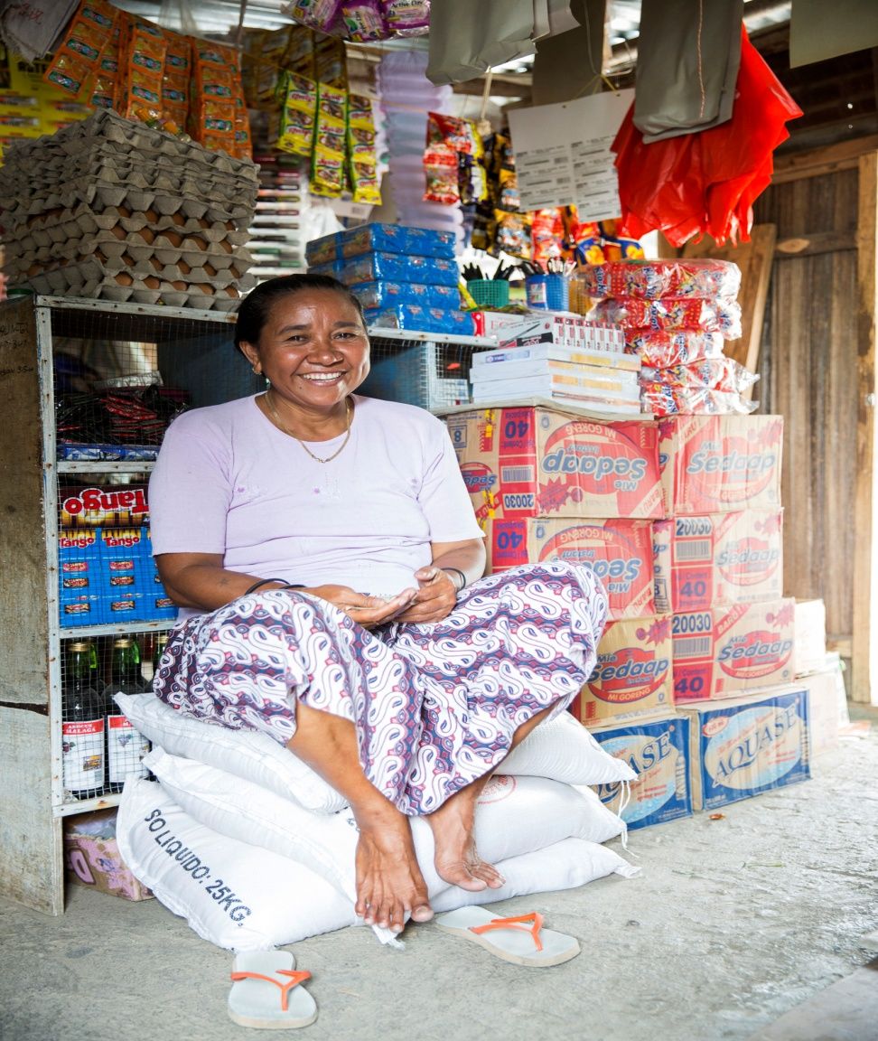
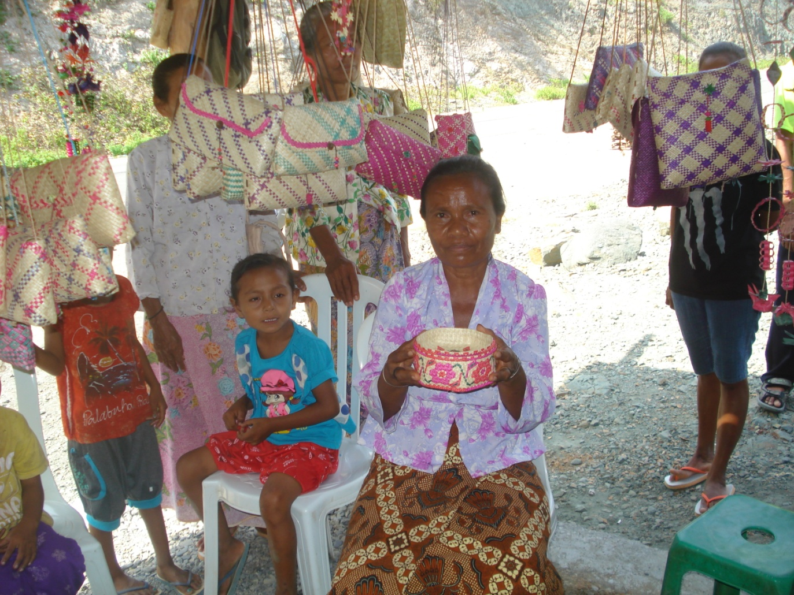
The Success of UBSP Group
We loaned money and bought the equipment and handicraft
I loaned money to set up my small kios business
FG UBSP Fila Liman – Maubara, Liquica
FG UBSP Hametin Unidade – Zumalai, Covalima

Slide 16
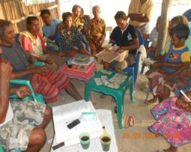
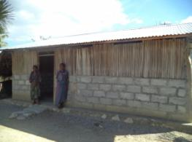
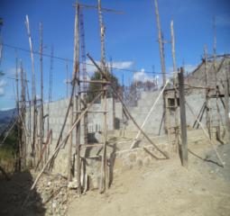
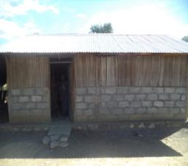
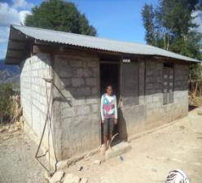
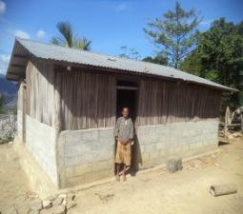
Location Ulas - Oecusse
Mr. Use the result from UBSP for building his new house Hironimo Elu
2) Has 4 members of UBSP Group building the semi permanent houses use fund from UBSP.

Slide 17
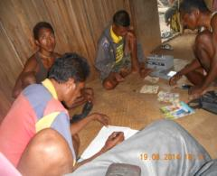
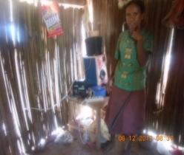
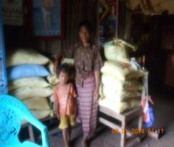
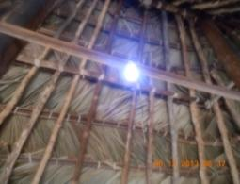
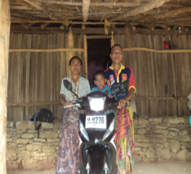
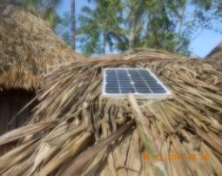
Location Maunaben-Oecusse
One member of group (Mr. Domingos Teos) already bougth 1 motorcycle as $. 1,500.00
Five groups of UBSP make the small business of sale rice in their villages (kelk Eno Bitimo, Nekaf Mese, Moin fe’u, Tasek Sule, Fitun Foinsa’e)
4 members in Maunaben use fund from UBSP for bought electricity power /tenaga surya with prices per unit as $90-$150 (Mrs. Marta Haki, Matilda Quelo, Mr. Batista Tolo and Agostinho Tolo)

Slide 18
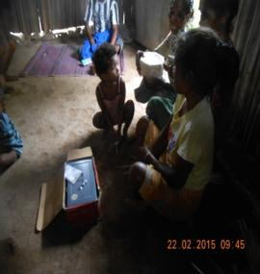
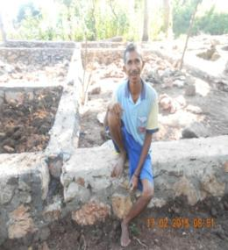
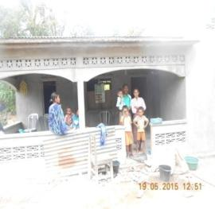
Location Nonkikan - Oecusse
Five members use UBSP fund for bought five catles with prices $. 200 per catle; Jacinta Nesi, Sabina Tolo, Domingas Tolo, Imaculada Naub, Filomena Naub
One household loans money from UBSP for build the permanent house (Mrs. Rofina Elu)
One member loans money in UBSP group for build the new permanent house. (Catarina Neno)

Slide 19
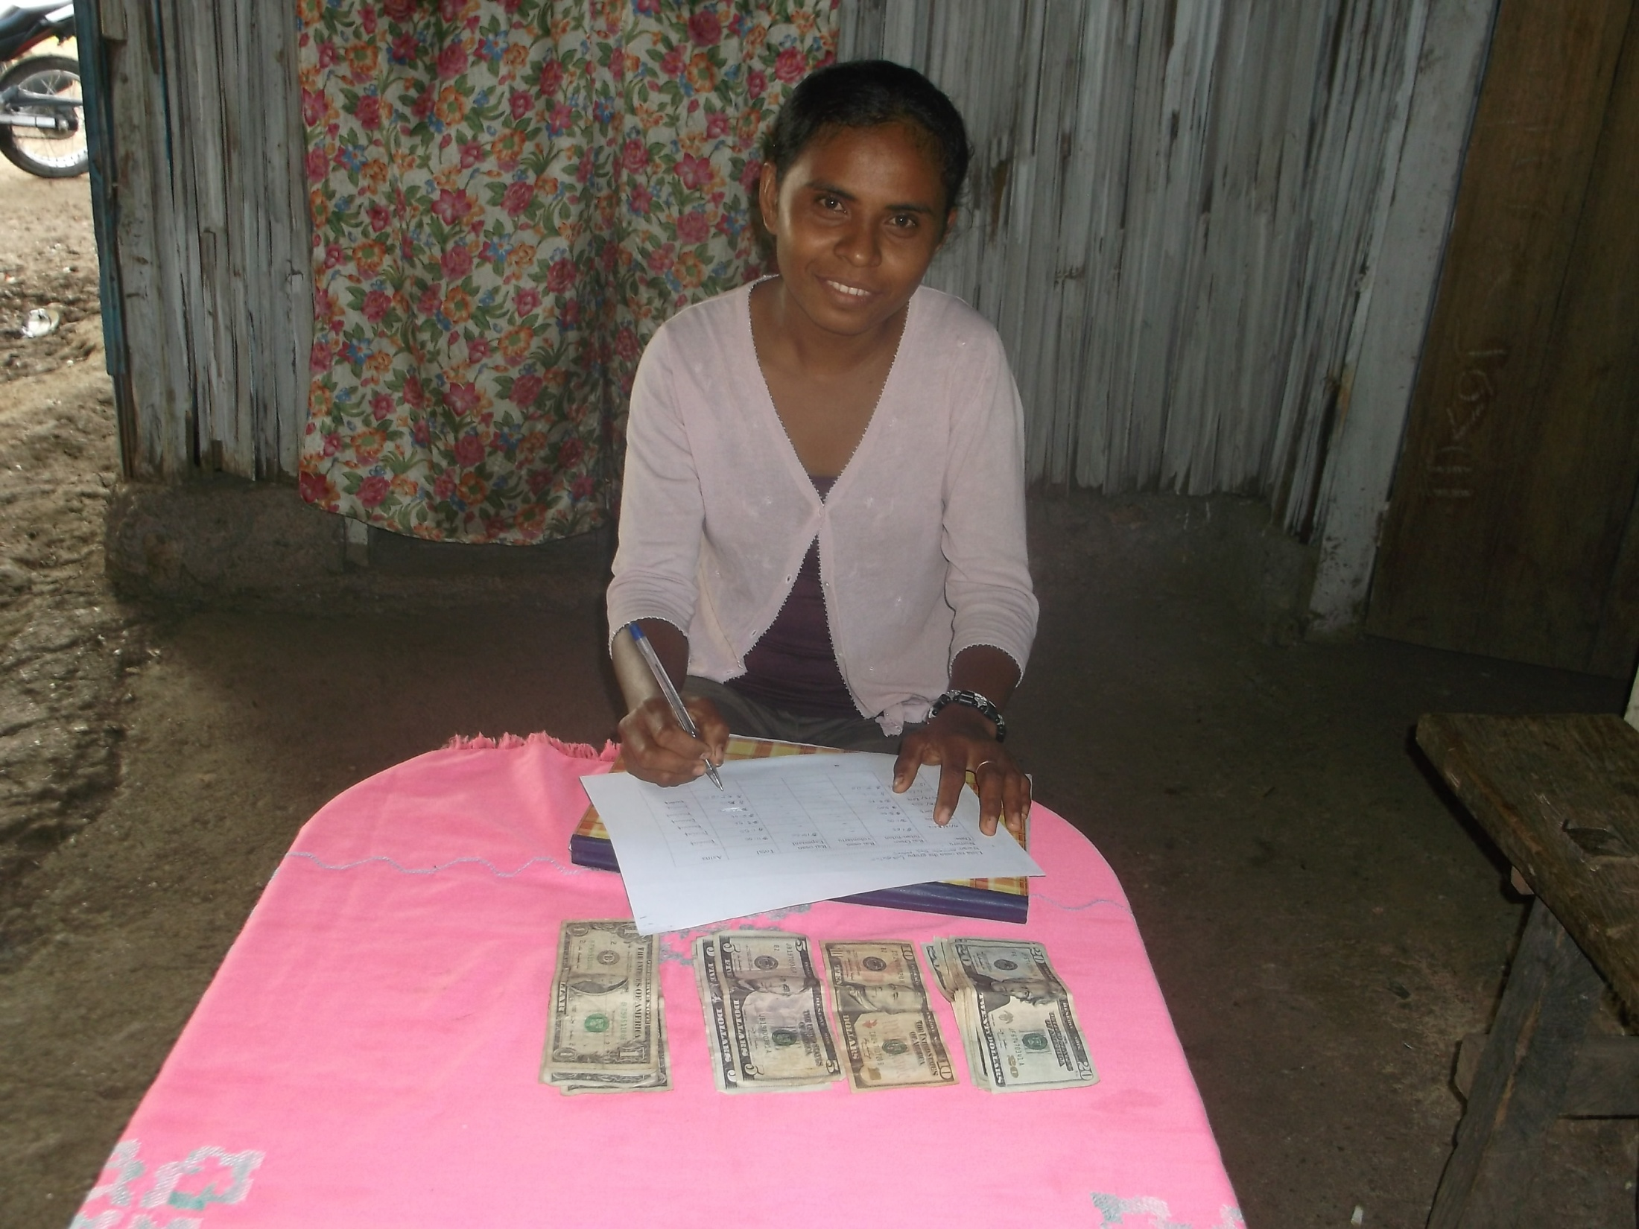
Thank You

